Slide 1
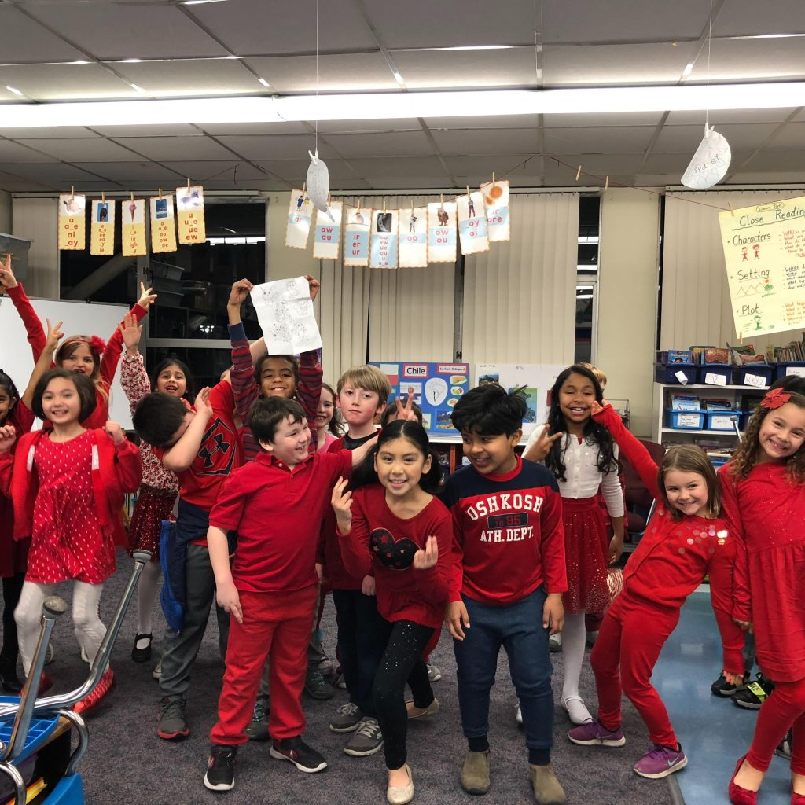
Welcome to 2nd Grade!
1) Have a seat at your child’s desk. Curriculum materials are there for you to take home.
2) Interested in helping in the classroom? Please email us. ☺
3) Didn’t receive the “Welcome to 2nd Grade” letter via email (last week)? Write your email on a sticky note.

Slide 2
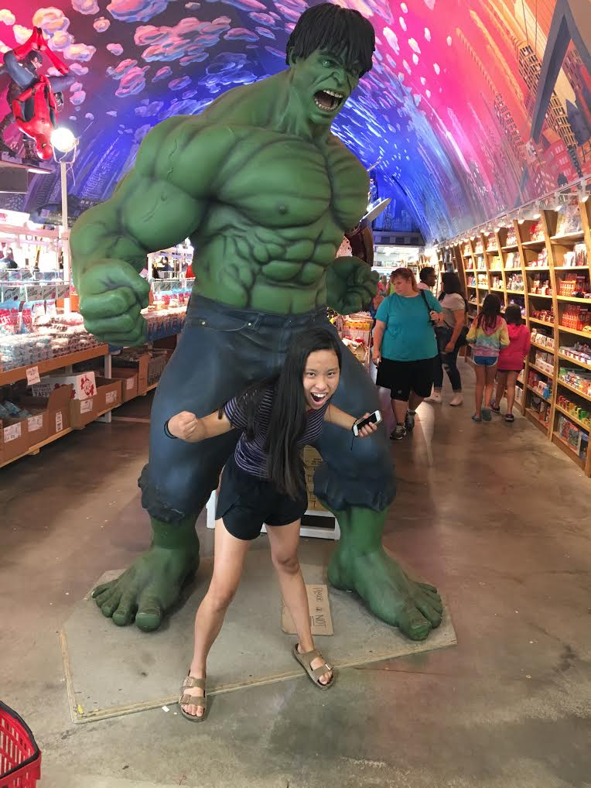
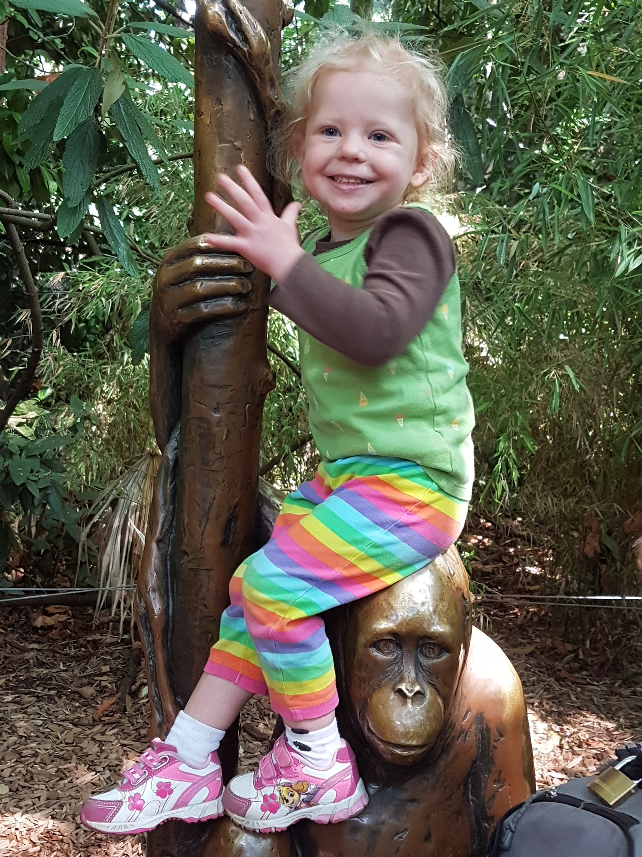
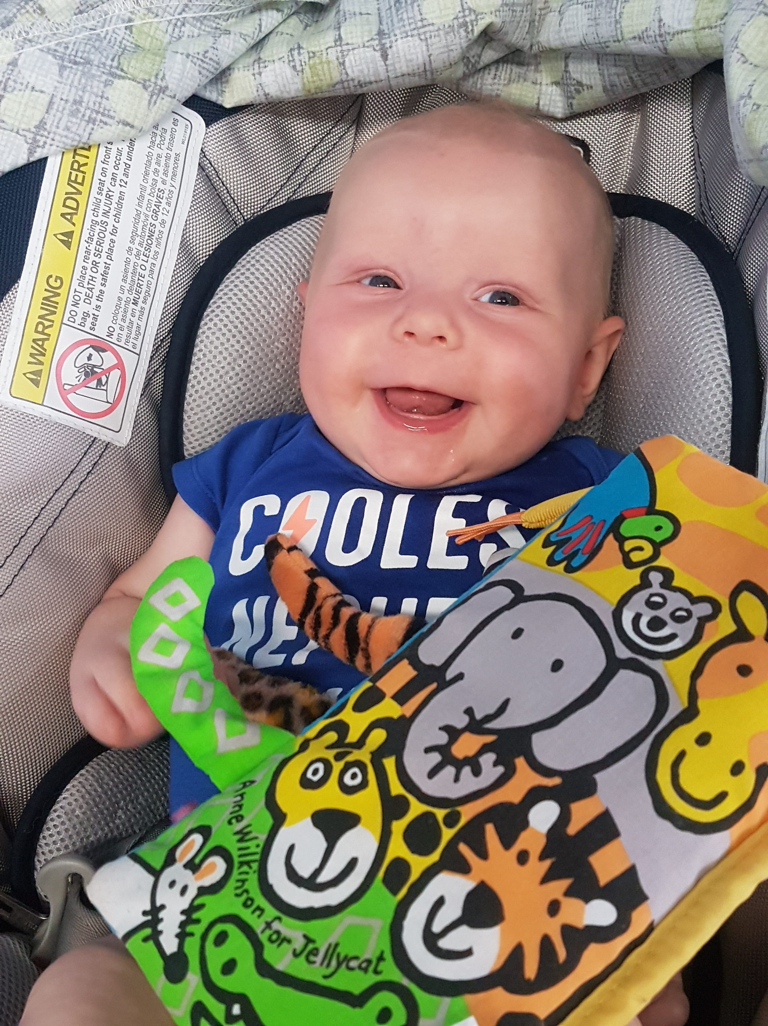
Introductions
Mrs. Hoch
* 15th year at OLG
* 15 years in University Ministry & Faith Formation
* Bachelors of Art in English
* Masters of Arts in Teaching
Hobbies:
All things outdoors (cycling, running, swimming, triathlons, hiking, camping, exploring)
Ms. Zbaracki
* 27thyear at OLG
* Bachelors of Art in Early Child Care and Development
* 180+ credits of continuing education in language arts, science, math, outdoor education, religion, and the arts
Hobbies:
Walking, reading, cycling, singing, hiking, baking, and family time

Slide 3
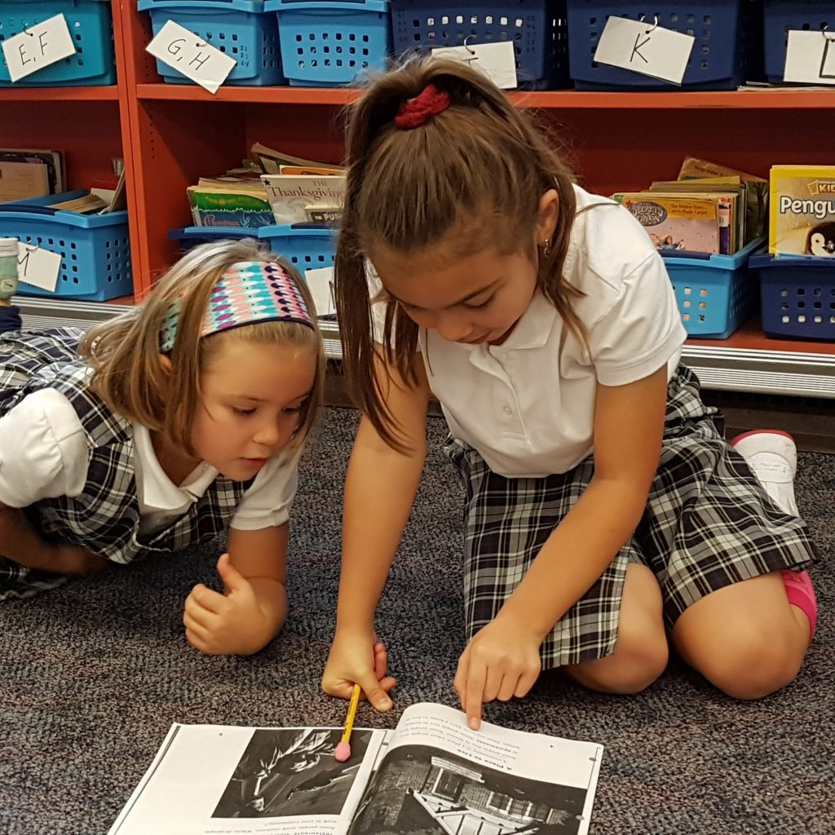
Curriculum Packets
Info about: * Curriculum * Service Projects * Policies– (homework, communications, behaviors, birthdays, etc.) * Reading Strategies & Coaching Sheets (on website) * Important Dates – Sacramental Prep
* Safe Environment training (for all volunteers) * Communication info – primarily email & website
* Sacramental Preparation Details, Details, Details

Slide 4
Curriculum Highlights
Math
Math InFocus curriculum materials. Add & subtract multi-digit numbers. Quick recall of facts to 20. Measuring to nearest ½ inch and centimeter. Telling Time to the minute. Counting money and making change. Homework will be either written pages or skill practice (games, etc.)
Literacy/Language Arts – SIPPS & Reader’s Workshop model (UNIT-based, connected to Science & Social Studies) Systematic Instruction in Phonics, Phonemic Awareness & Sight Words (SIPPS) – small group foundational skill development. Strategies for comprehension and decoding of literary & informational texts. Learning what to do when we “get stuck.” Learning to be independent readers (building stamina as readers). Writing includes various reading responses, as well as narrative, opinion/persuasive, & informational writing. (Daybook curriculum materials, Lucy Calkins writing series). Spelling Workout curriculum for high frequency and sight words. Spelling work will be done as homework. Spelling Tests will be given on the last day of the week.
Religion
Sacramental Prep (Reconciliation & Eucharist/First Communion). Roman Missal 3 – new prayers and responses. Nurturing personal relationship with God/Jesus through stories, reflections, gratitude journals. Sacred Story meditation series.
Social Studies (Mrs. Hoch – M, Th, Fr)
Integrated Language Arts units focusing on community, Japan, South America, (Europe).
Science (Ms. Zbaracki – Tues/Wed)
FOSS Kits: (1) Plants, (2) Solids & Liquids, (3) Balance & Motion

Slide 5
Curriculum Highlights
Big Projects:
Baptism/Birth day Project –
Sharing the story of your child’s baptism. If your child is not been baptized, please share the story of their birth day. (Nov/Dec)
South America Research Project –
Your child will choose one country in South America to research & create a visual/creative project to present to the class. This project will be completed entirely at home & is intended to be a family learning experience.
(Nov/Dec – presentations hopefully before Christmas break)
First Communion Banner –
Children will be asked to create a banner about what Eucharist means to them. We will give you the basic templates and all instructions, you & your child will create the banner at home. (March/April)

Slide 6
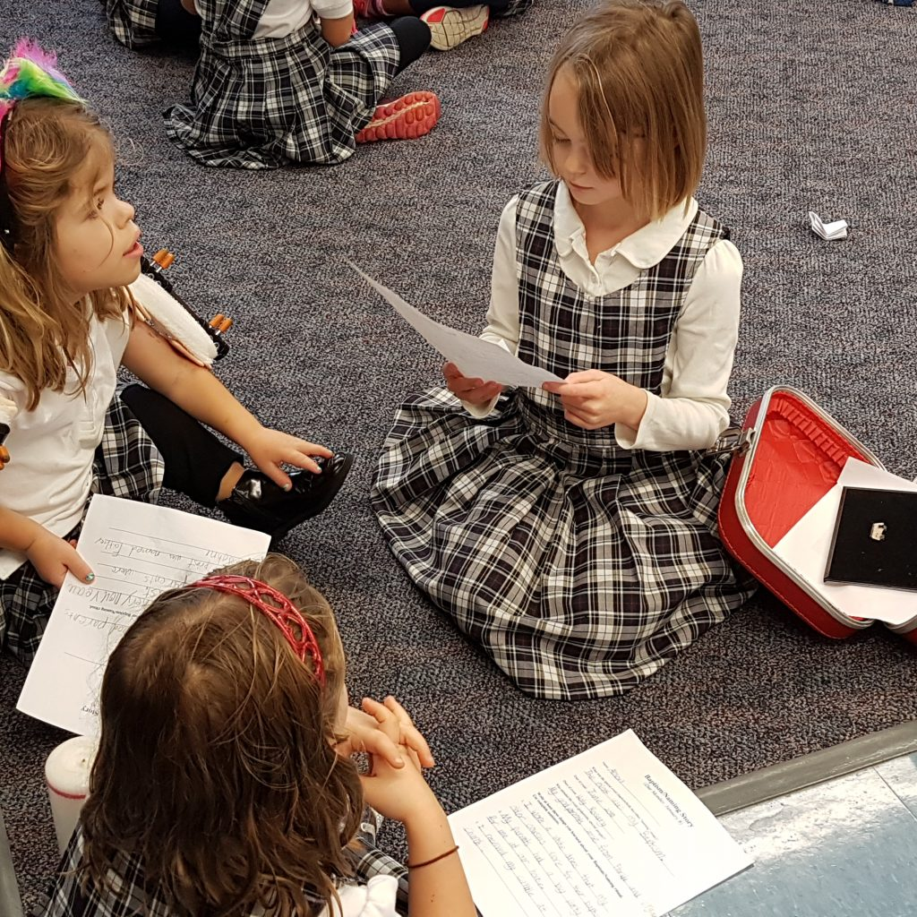
Grading
GRADING OF STANDARDS
4 – Above/Exceeds Standard
Demonstrates independent skill well-above grade-level standards, independently, with NO major errors or omissions in info or processes.
3 – Meeting Standard
Independently completes grade-level work with NO major errors or omissions regarding any of the grade-level info &/or processes (simple or complex) that were explicitly taught.
2 – Approaching Standard
Independently completes work with no major errors or omissions regarding the simpler DETAILS & processes BUT major errors or omissions regarding the more complex ideas &processes.
1 – Below Standard
Requires significant help to understand info & processes & to accurately complete assignments.

Slide 7
Behavior Management
Behavior Cards: Green – Yellow – Orange– Red
If your child goes to red, a note will be sent home and/or I will contact you.
Flower Charts
Children color their chart to match their behavior cards for each day. They bring it home on Friday. Please sign it and send it back on Monday.
WOW Chart
Class incentive chart.

Slide 8
Odds & Ends
Uniforms Please write your child’s name in sweaters, jackets, vests. It helps us get “lost” items to their owners.
Please realize that Boots (of any kind) are NOT uniform, even in inclement weather. If your child wears boots to school, please make sure they have uniform shoes to wear during the day.
Jackets Please make sure your child has one everyday. The weather changes quickly, and should there be an emergency we want to make sure they are always warm & dry.
Drop Off/Pick Up Drop off begins at 8:15am. Please do not drop off earlier. Please pick up your child at the sidewalk north of the Big Toy.

Slide 9
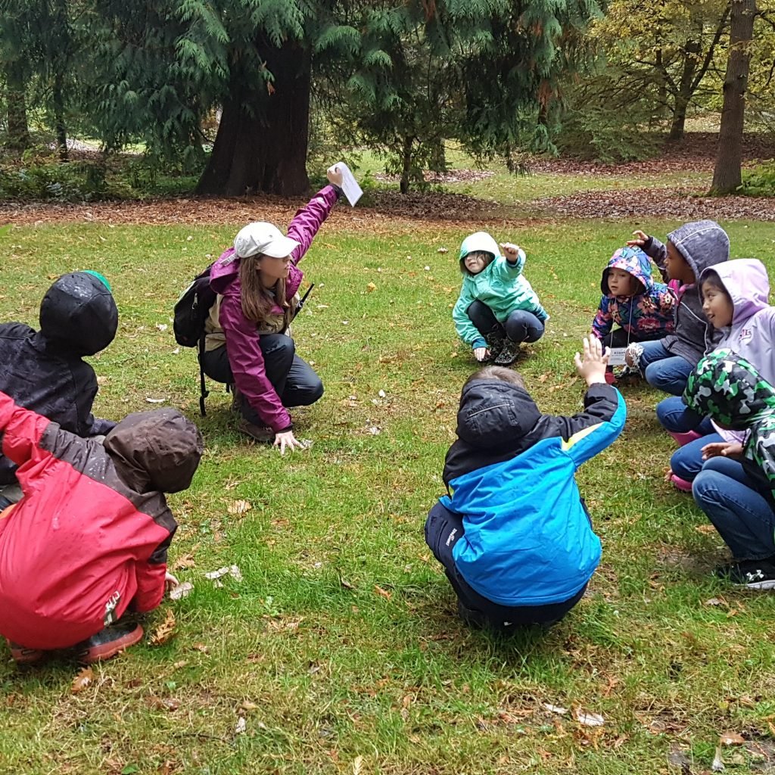
Field Trips
We’ll let you know about Field Trip dates as soon as possible.
Using the online FACTs system to submit payments for trips
Permission forms will still be hardcopy & need to be returned to classroom teachers.
Please plan to join/help us on the adventures, if possible. We’ll need drivers & chaperones for each trip. Thank you! (Safe Environment training)
Permission forms/waivers will come home at least 3 weeks in advance.

Slide 10
Safe Environment Training
The Archdiocese mandates that any adult who has direct contact with with our children MUST complete the Safe Environment (“Called to Protect”) Training before they may participate in activities with the children.
Visit the new Archdiocesan Safe Environment website for information about certification & trainings:
VirtusOnline.org
(Please correct/update this website in your packet!)

Slide 11
Sacramental Preparation
Format allows deeper faith experiences & aligns with OLG Parish 5-year plan goals. All gatherings are for parents AND children.
Registration forms are at your child’s desk. They are DUE at the October 14th gathering^{t}, along with a copy your child’s Baptismal certificate.
Reconciliation in Winter
First Communion in Spring
Family Gatherings – ALL dates are in your packet
1 Orientation (9:30-10:45)
3 SUNDAY Morning, Family Preparation gatherings (9:30-10:45am)
2 Saturday Family Learning Center reflections (10:00am-1:00pm)
1 Morning of Reflection (10:00am-Noon)
2 Sacraments
MARK DATES NOW – Plan vacations accordingly. Please tell sports coaches (spring) you won’t be available on Sac Prep mornings…really important for your child to have that time with you to prepare for the sacraments.

Slide 12
Communication
Mostly by email – please make sure write your address on a sticky note for us if you did ot receive the Welcome letter that was sent out last week.
If you prefer hardcopies of communications, please send us a note asking for hardcopies of newsletters, reminders, notes, etc.
Newsletters are typically about 2x/month (every other week). Sent via email & posted on website.
Email is best way to reach us.
rhoch@guadalupe-school.org and bzbaracki@guadalupe-school.org
Please include BOTH of us on all email communications so we can best support your child’s learning this year.

Slide 13
Parent Volunteers
Thank you to the Parents who have already volunteered to help our class throughout the year:
Room Parent – Erin Stampe
Parent Org. Reps. – Samantha Depue & Rachelle Snyder
Auction Parent –
Service Parent – Elicia Howell
Scholastic Book Orders – Steph Huske

Slide 14
Parent Volunteers
Other Volunteers Needed/Desired:
Take Home projects:
Pencil Patrol – sharpen pencils each weekend & send them back on Monday.
“Good News” help -- collating the Good News publications for use in class
Random Take Home projects – various projects that pop up throughout the year.

Slide 15
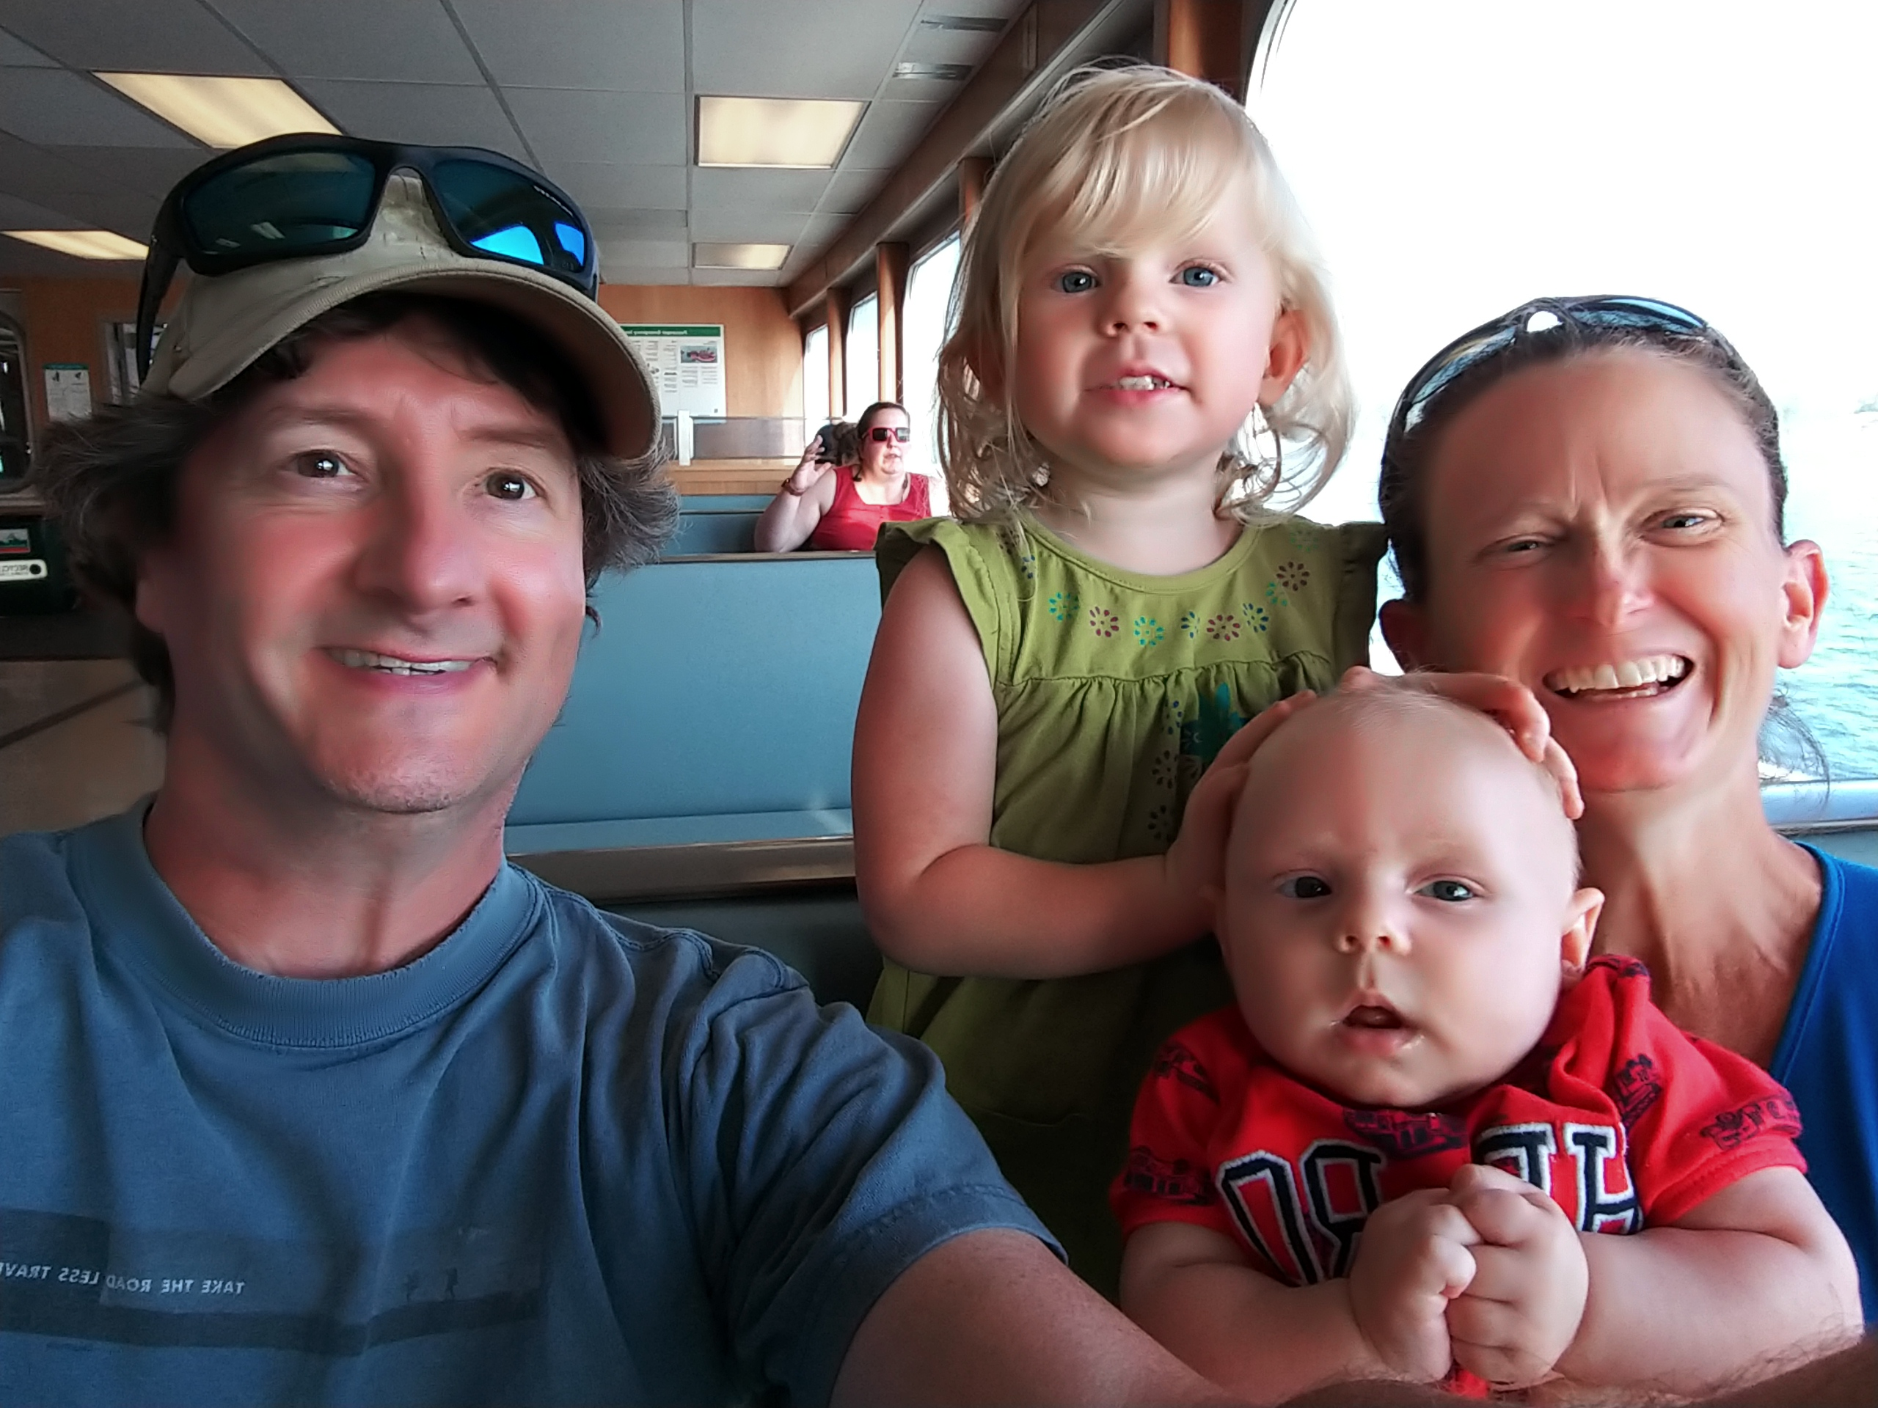
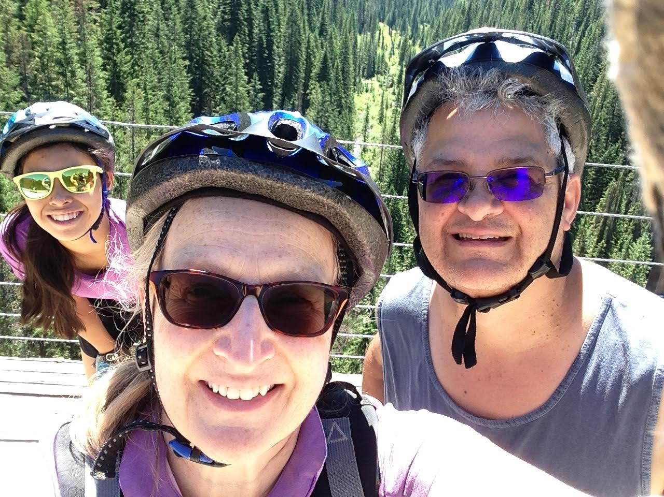
Thank you!!!
We look forward to journeying with you
this year!
~ Mrs. Hoch & Ms. Zbaracki

